Slide 1

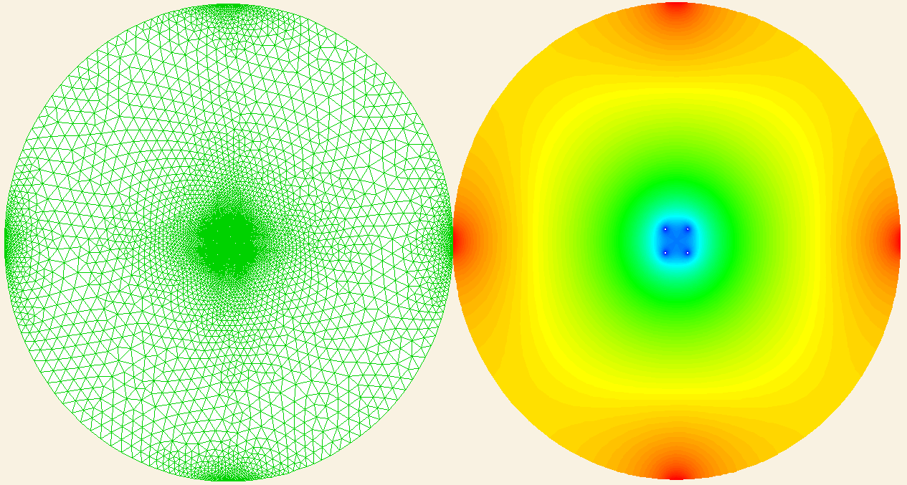
Calcium blinks modeling
Laboratory of Calcium Signaling, IMM
Xie Wenjun, Cheng Heping
2005.10.16

Slide 2

Background
Calcium blinks: rapid and substantial decreases in luminal [ca2+] within nanometer-sized stores (the junctional cisternae of the SR) during elementary ca2+ release events in heart cells
Blinks mirror small local increases in cytoplasmic [ca2+], or calcium sparks
During calcium blink, changes of [ca2+] in the connected free SR network were below detection
The refilling of local store is about 6-fold faster than the recovery of local calcium release after a spark

Slide 3
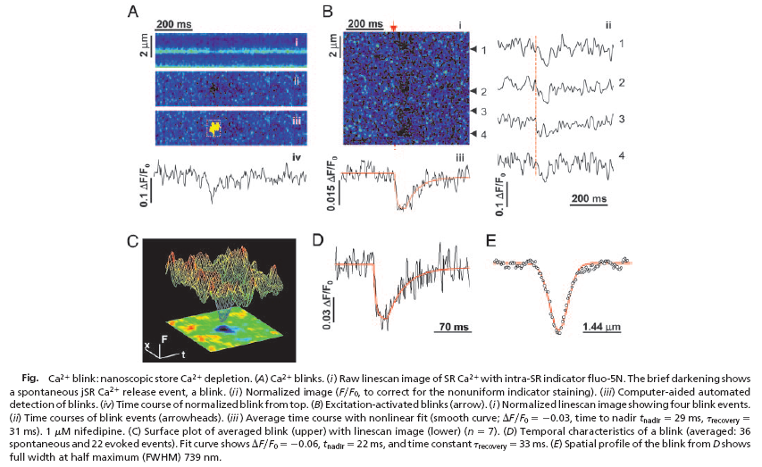

Slide 4
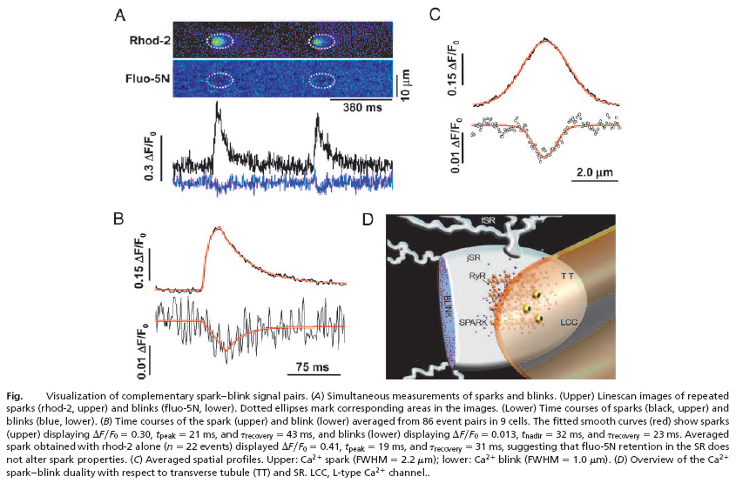

Slide 5
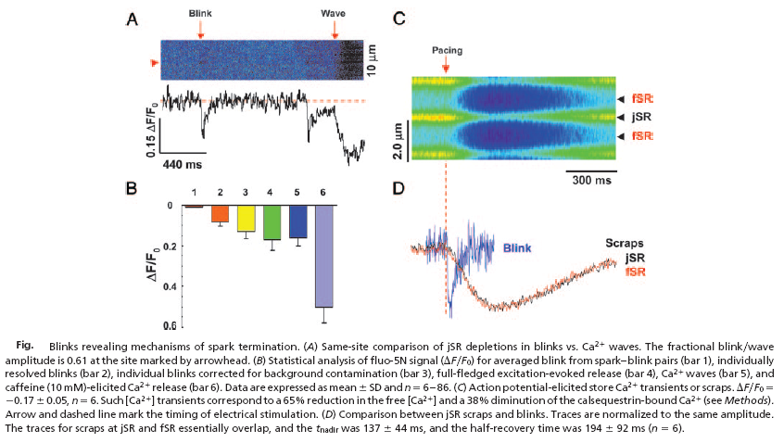

Slide 6
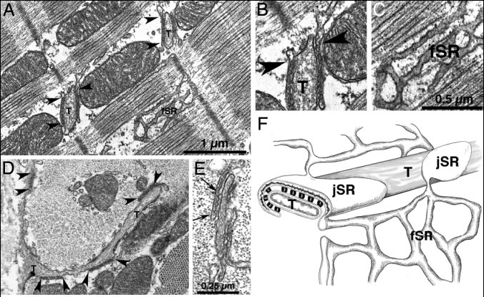
Fig. Microanatomy of SR in rabbit cardiac cells. (A) Longitudinal section of rabbit left ventricular myocyte, showing junctional SR (jSR) cisternae near T tubules (T) and free SR (fSR). Arrowheads indicate continuities between jSR and fSR. (B and C) Details fromA. Connections between jSR and fSR (arrowheads in B) were seen in 60 of 136 cisterna profiles in 60-nm-thick sections only at the periphery of the flat jSR cisternae. The average number of connections was therefore estimated to be 4.3 for a 592-nm-diameter jSR cisterna. (D) Tangential view of fSR network: Cross section at the level of the Z line. jSR cisternae (bracketed by arrowheads) are apposed either to T tubules (T) or the surface membrane. Profiles of fSR are seen next to a mitochondrion. (E) The cytoplasmic domains of ryanodine receptors (RyRs) are seen as feet in the gap between jSR and T tubule membranes (between arrows). (F) Diagram showing the relationship between the fSR network, the flat jSR cisternae, T tubules, and feet in rabbit ventricle.

Slide 7
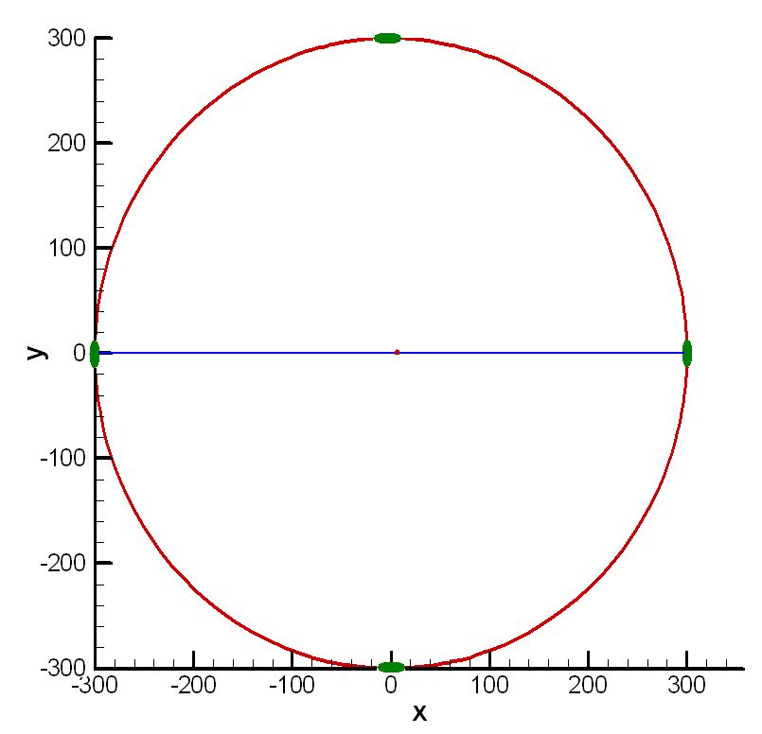
The Geometry of jSR model
The jSR is modeled as a 2D circle with a diameter of about 600nm;
The jSR connects to fSR at four symmetrical sites along its periphery; the width of each connecting tubule is 30nm;
RyR channels are modeled as circles with diameter of 2nm, which situated on the jSR circle;
The blue line in left figure is the simulative scanline.

Slide 8
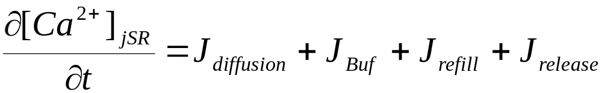
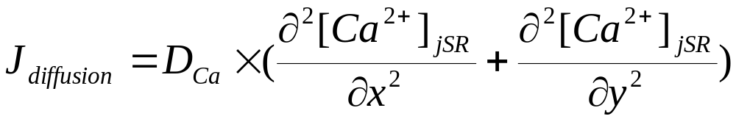
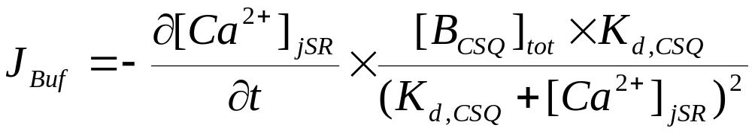
Mathematical description of jSR Calcium Release (1)
We modeled the calcium diffusions induced by concentration gradients in SR cisterna. The balance equation of jSR Calcium concentration is
The local diffused flux is given by Fick’s second low as
Buffering in the jSR by calsequestrin uses the rapid buffering approximation, so

Slide 9
Mathematical description of jSR Calcium Release (2)
The refilled flux includes two components: JfSR and Jpump. Since JfSR>>Jpump, so
The release flux by RyRs is given by
Considering RyR release flux and fSR refill flux only occur at the boundary, the Jrelease and Jrefill are treated as boundary conditions in our models.

Slide 10
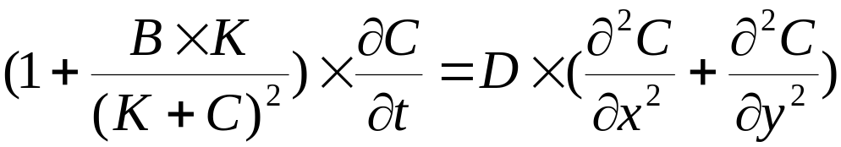
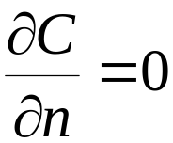

Mathematics Modeling
Diffusion Equation
boundary conditions
In outflow and inflow boundaries, the corresponding fluxes are added to the right of the equation;
In wall boundary, no normal diffusion occurs, so
Initial condition

Slide 11
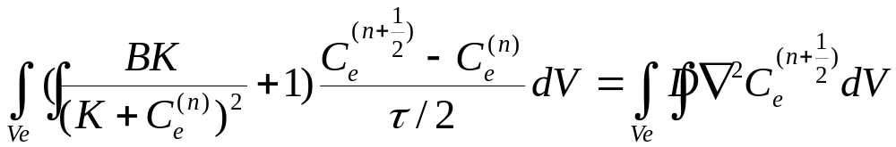
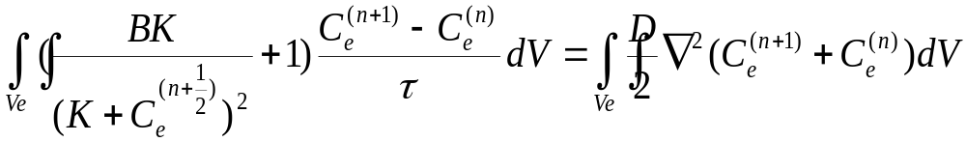

Numerical solving
Numerical method: finite-volumn methods
Mesh: unstructured grid
Scheme:
In each triangle element, we adopted 1-order polynomial to approximate the concentration value
Scheme accuracy:

Slide 12
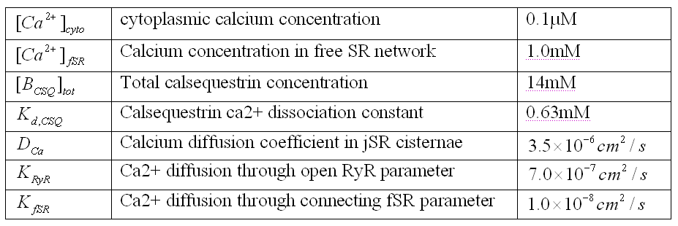
Parameters Table

Slide 13
Simulated Cases
Single RyR channel opening
RyRC located in (0, 0)
RyRC located in (86, 50)
RyRC located in (180, 90)
2 RyRs opening at the same time
RyRCs located in (0, 0) and (86, 50)
3 RyRs opening at the same time
RyRCs located in (0, 0), (86, 50) and (180, 90)
2x2 RyRs array opening at the same time
RyRCs located in (15, 15), (-15, 15), (-15, -15) and (15, -15)
Single RyR channel opening with changed parameters
RyRC located in (0, 0)
In these cases, the RyRCs is closed factitiously after 20ms’ opening

Slide 14
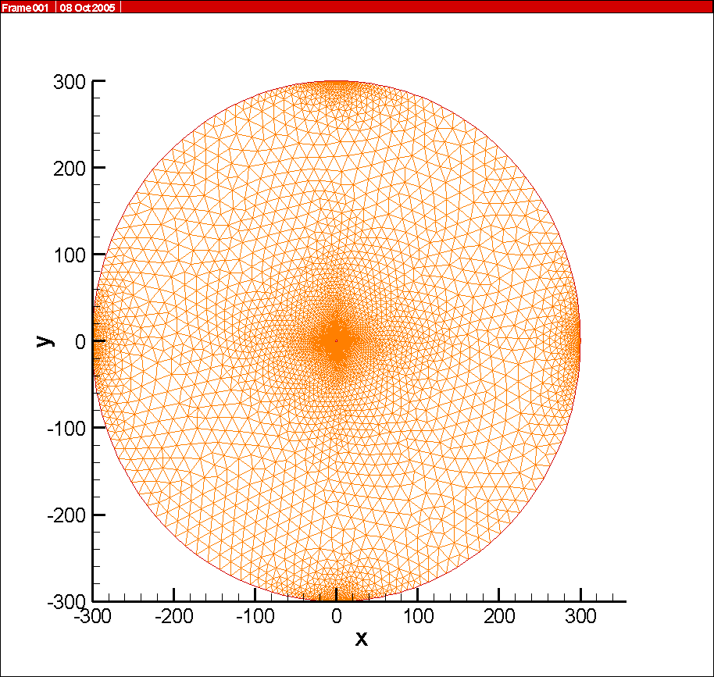
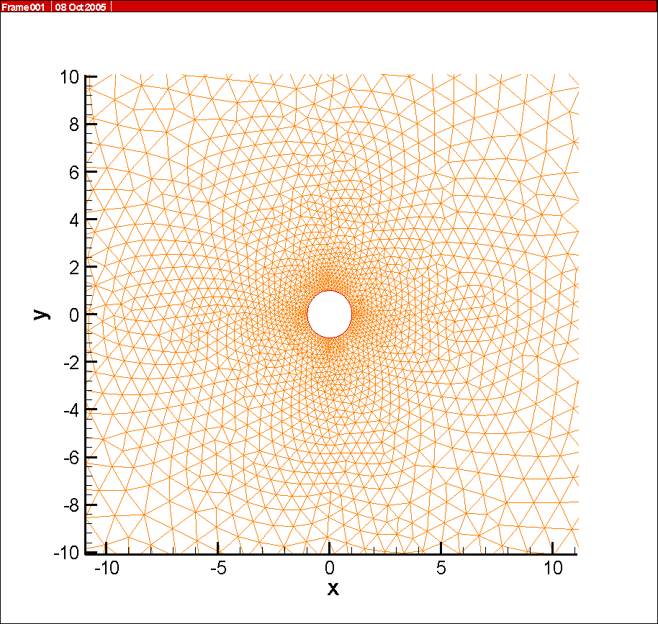
Single RyRC opening: unstructured grids (1)
The RyR Channel located in (0, 0).
grid with total 6413 nodes and 12444 triangle elements

Slide 15
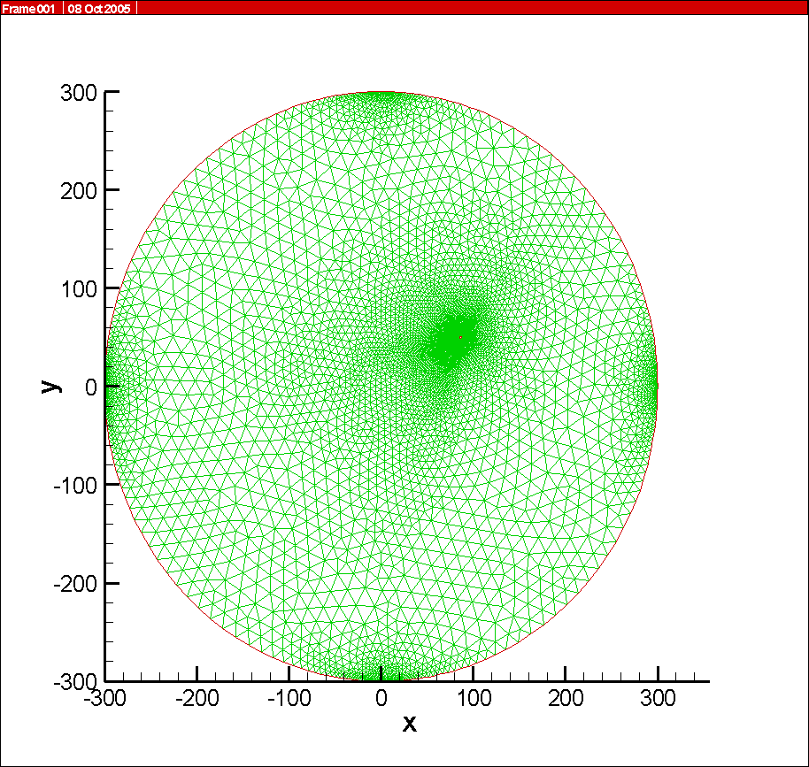
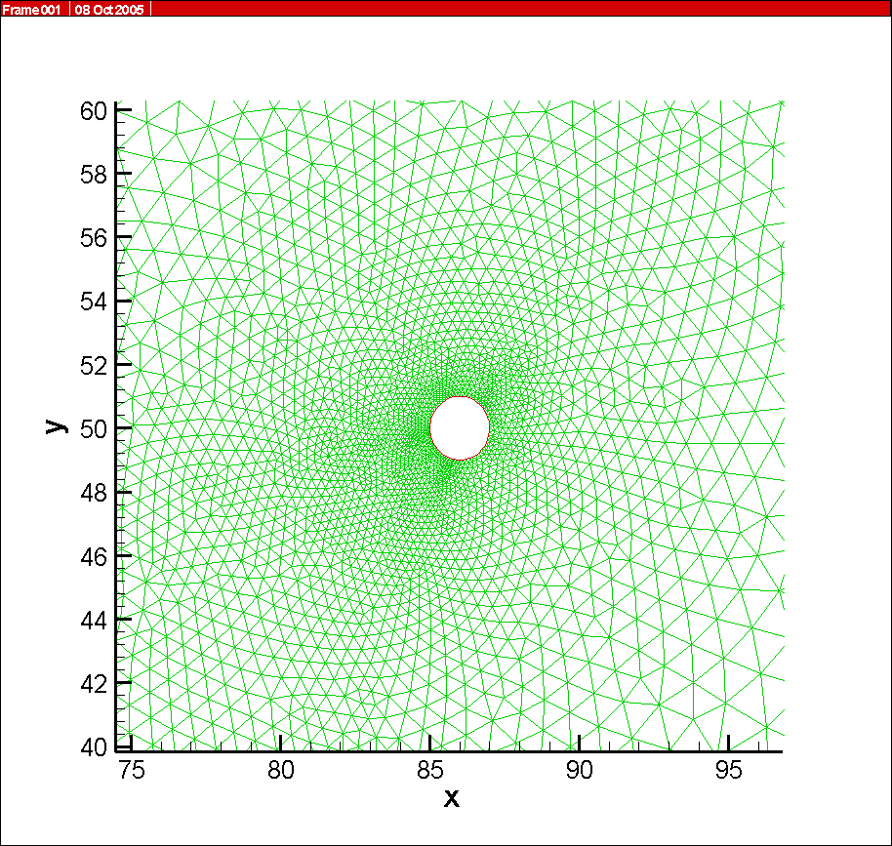
Single RyRC opening: unstructured grids (2)
The RyR Channel located in (86, 50).
grid with total 7551 nodes and 14718 triangle elements

Slide 16
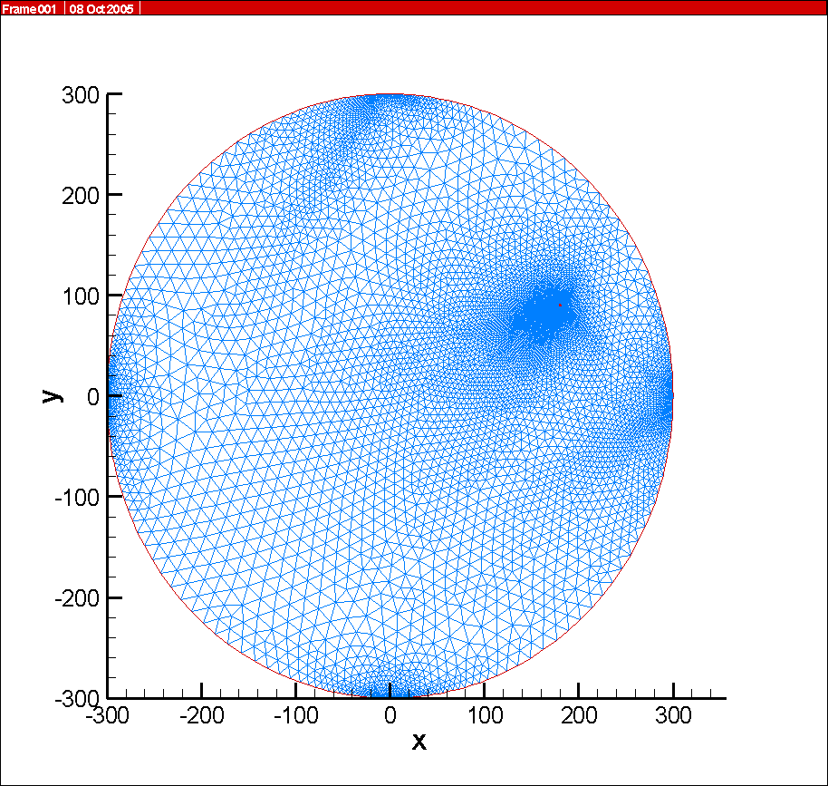
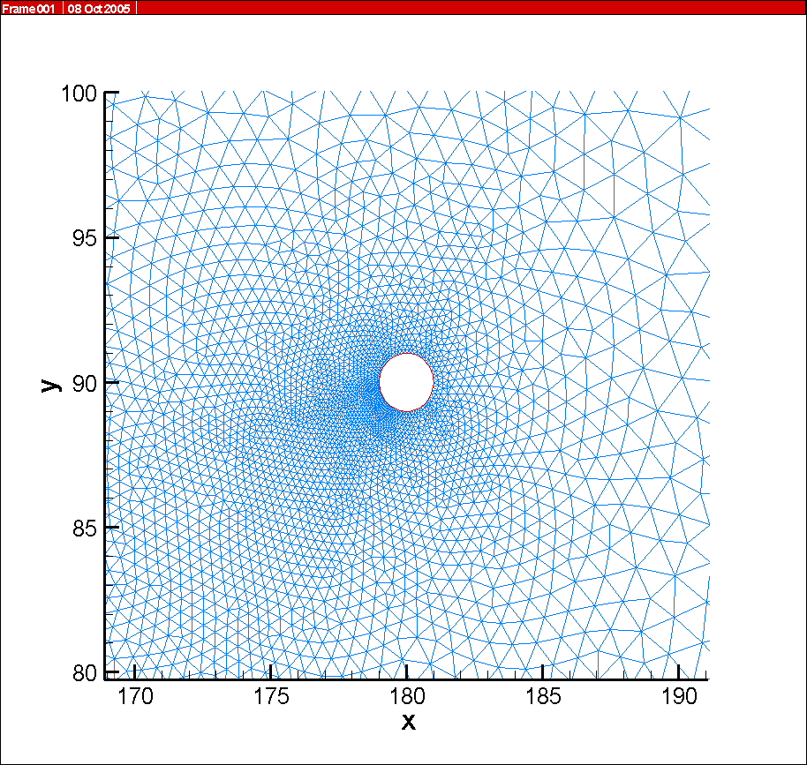
Single RyRC opening: unstructured grids (3)
The RyRC located in (180, 90).
grid with total 9511 nodes and 18637 triangle elements

Slide 17
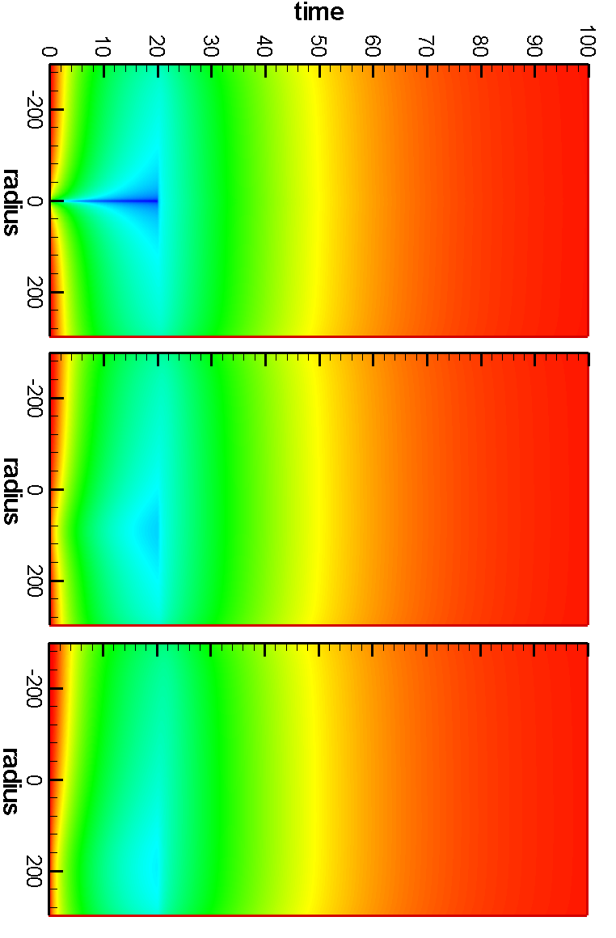
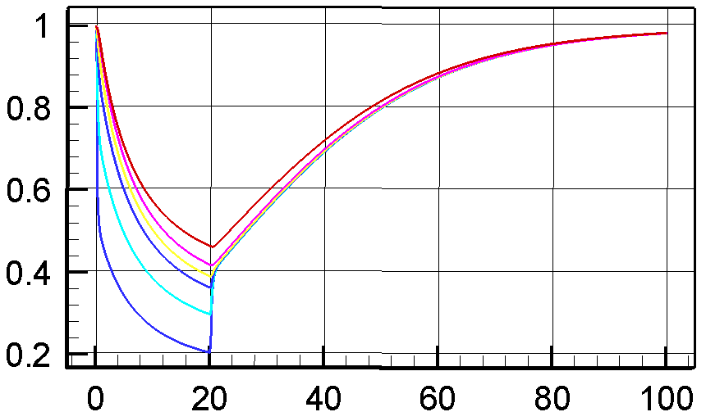
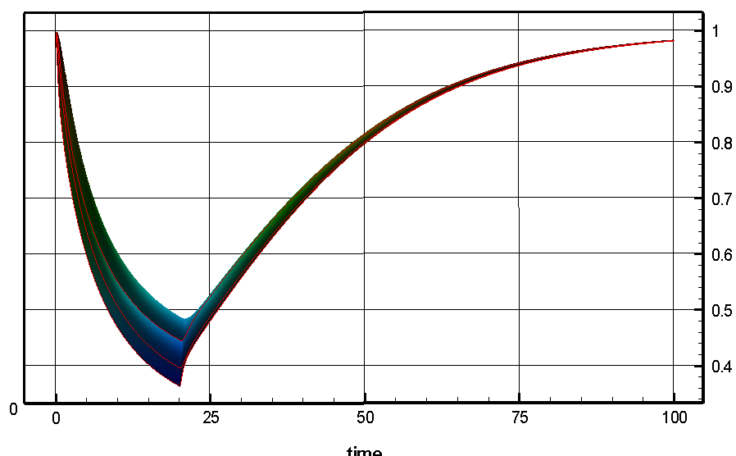
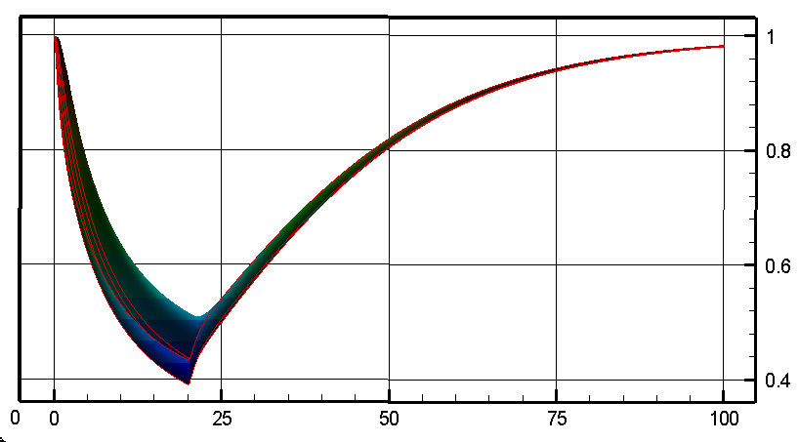
Single RyRC opening: Simulated calcium blinks (1)

Slide 18
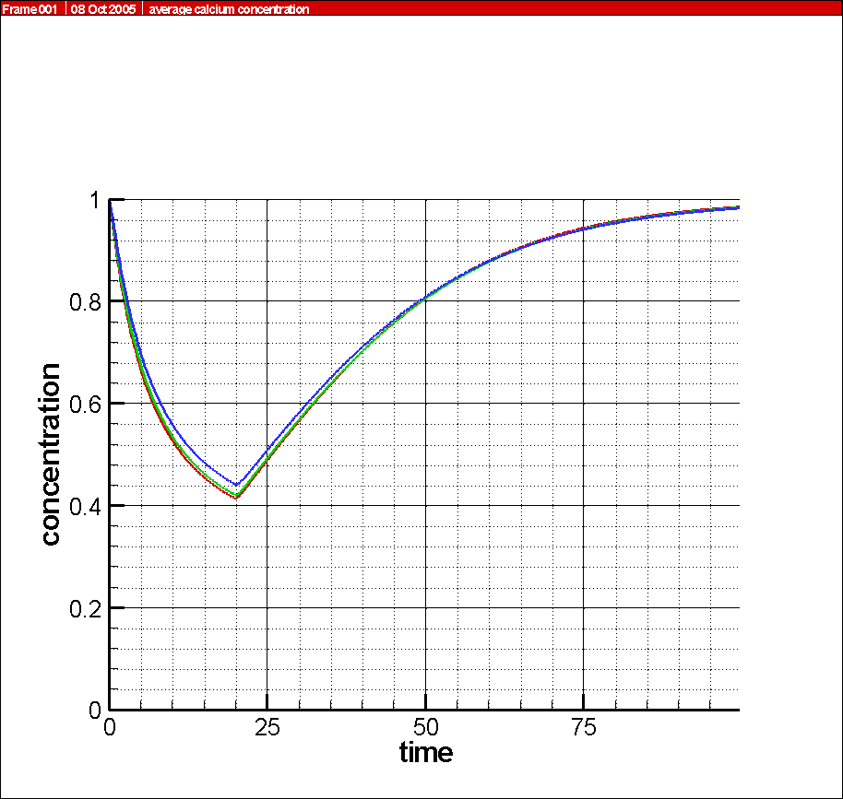
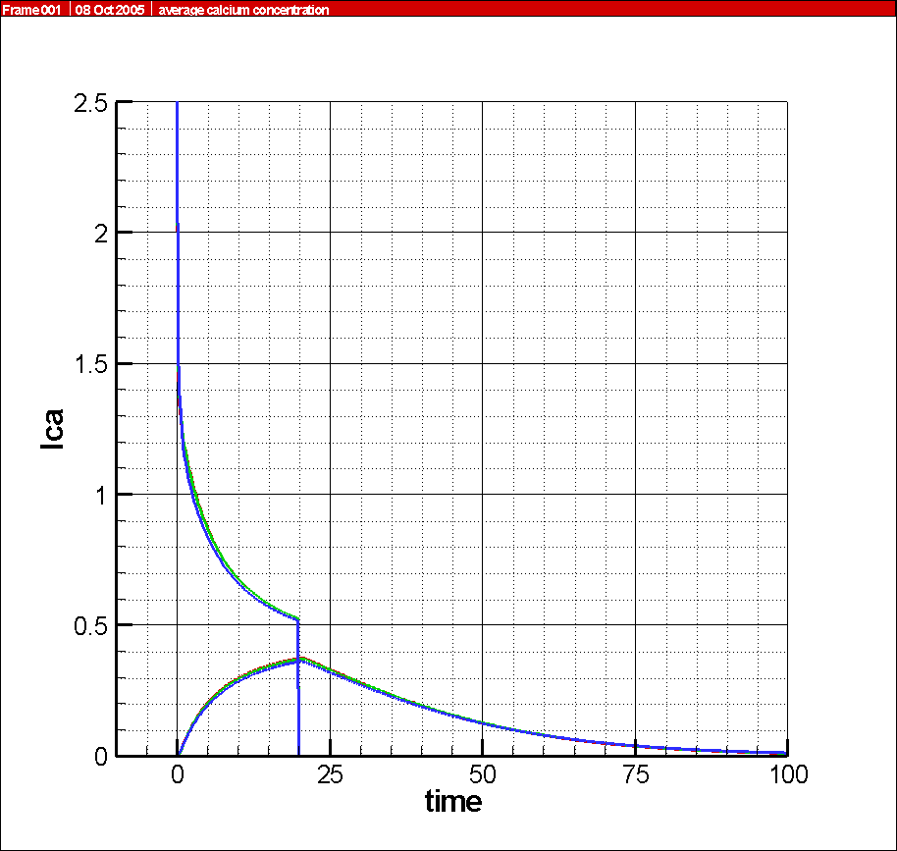
Single RyRC opening: simulated calcium blinks (2)
Left: Average jSR [Ca2+] versus time
Right: inflow and outflow Calcium currents versus time

Slide 19
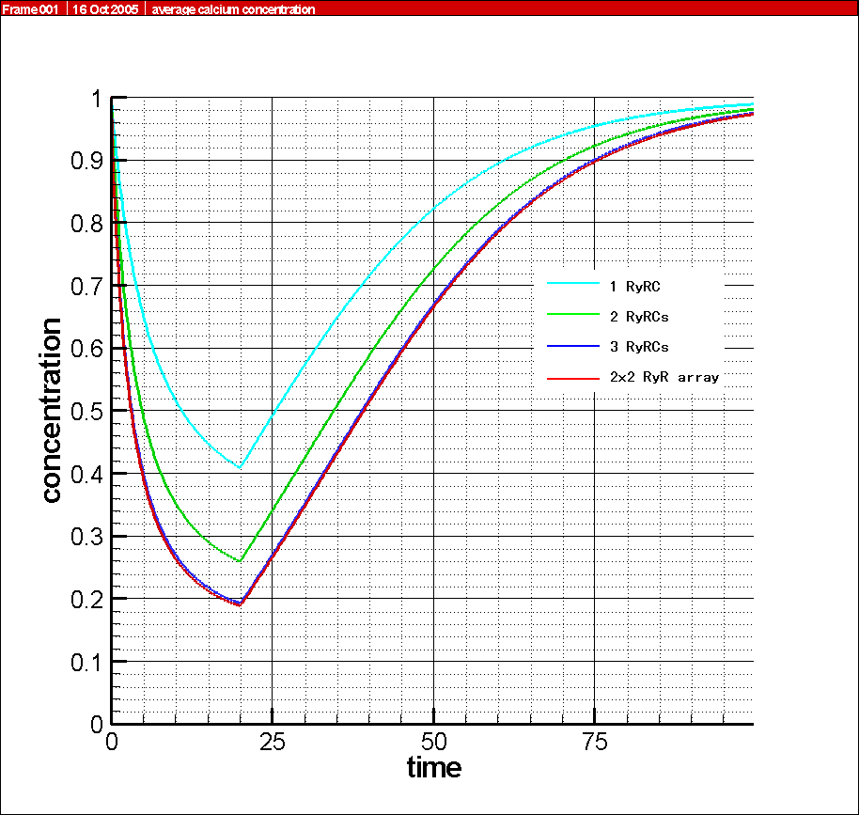
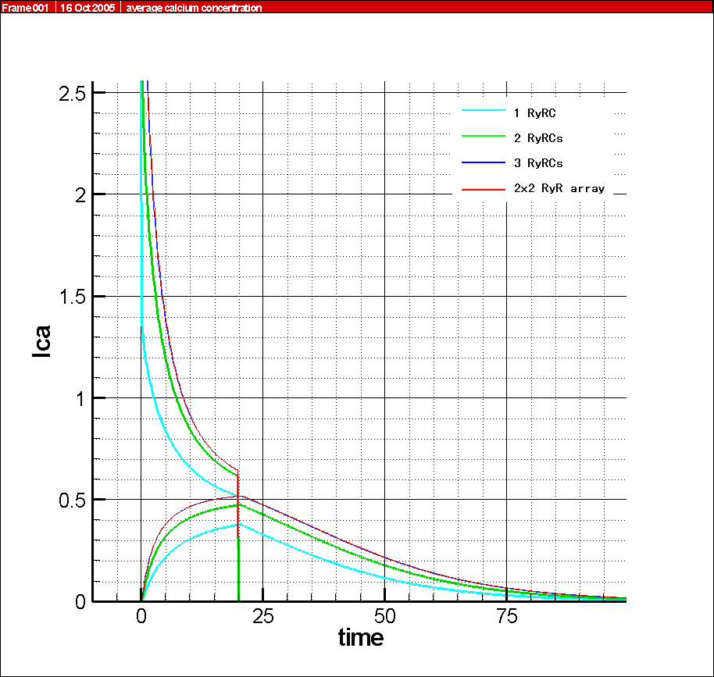
Several RyRCs opening
Left: Average jSR [Ca2+] versus time
Right: inflow and outflow Calcium currents versus time

Slide 20
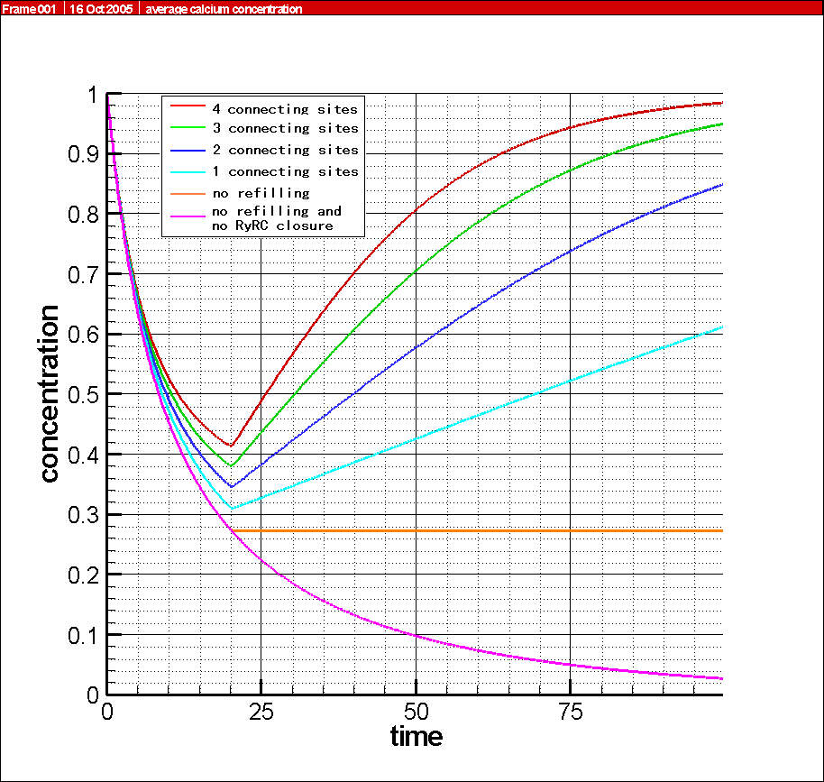
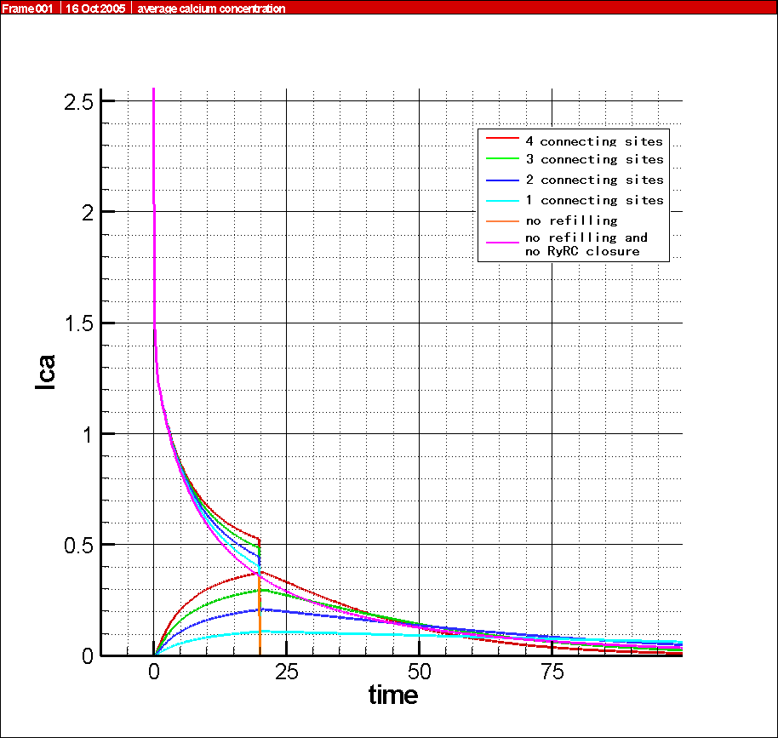
Single RyRC opening with changed connecting sites with fSR
Left: Average jSR [Ca2+] versus time
Right: inflow and outflow Calcium currents versus time

Slide 21
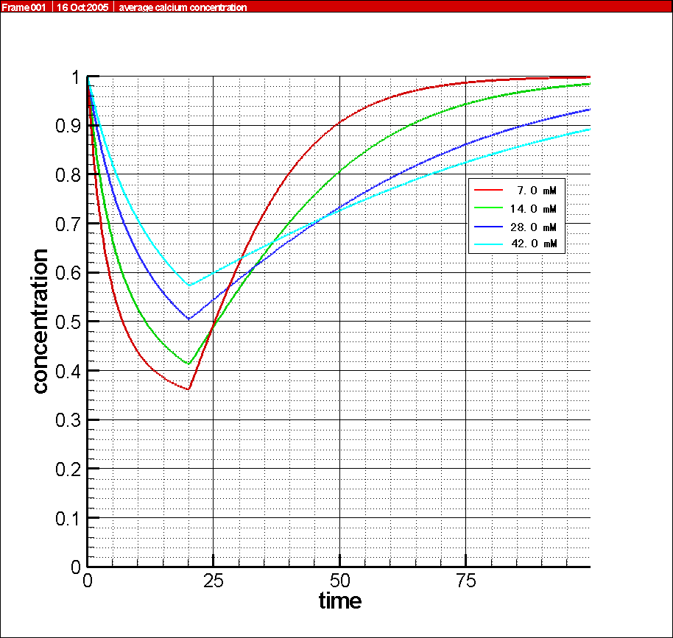
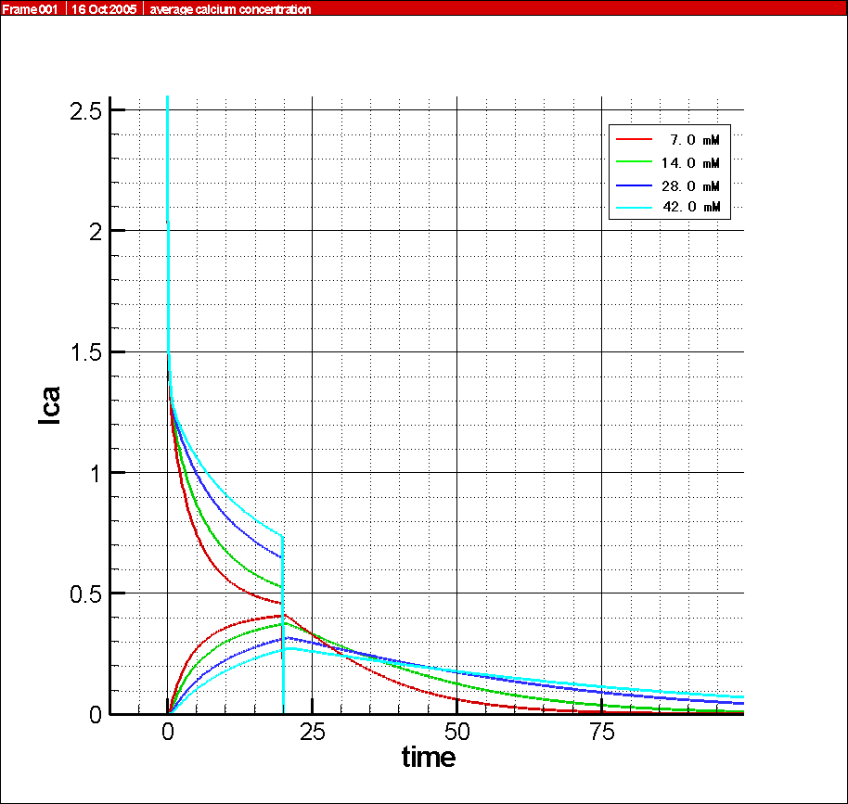
Single RyRC opening with changed [BCSQ]tot
Left: Average jSR [Ca2+] versus time
Right: inflow and outflow Calcium currents versus time

Slide 22
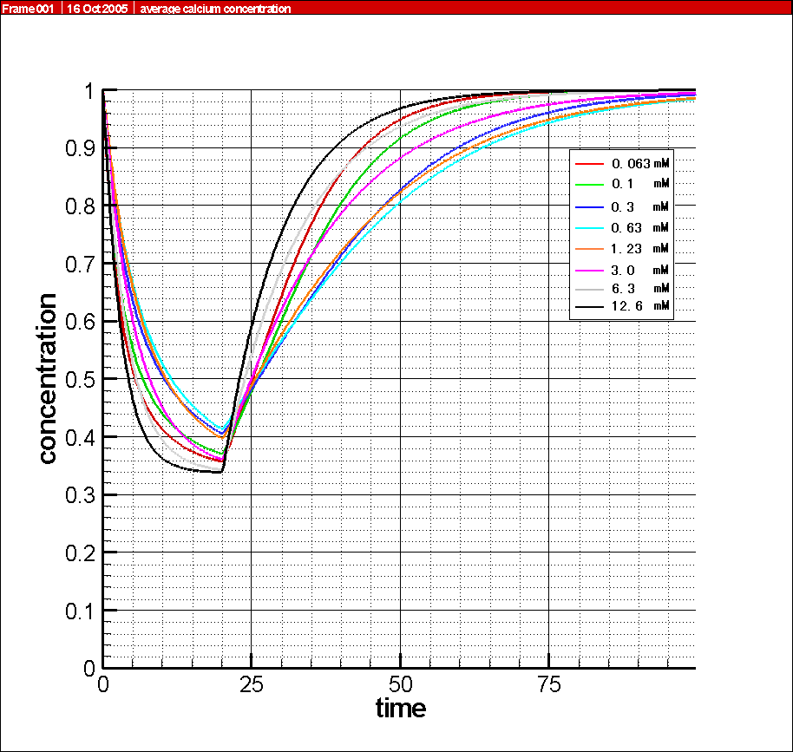
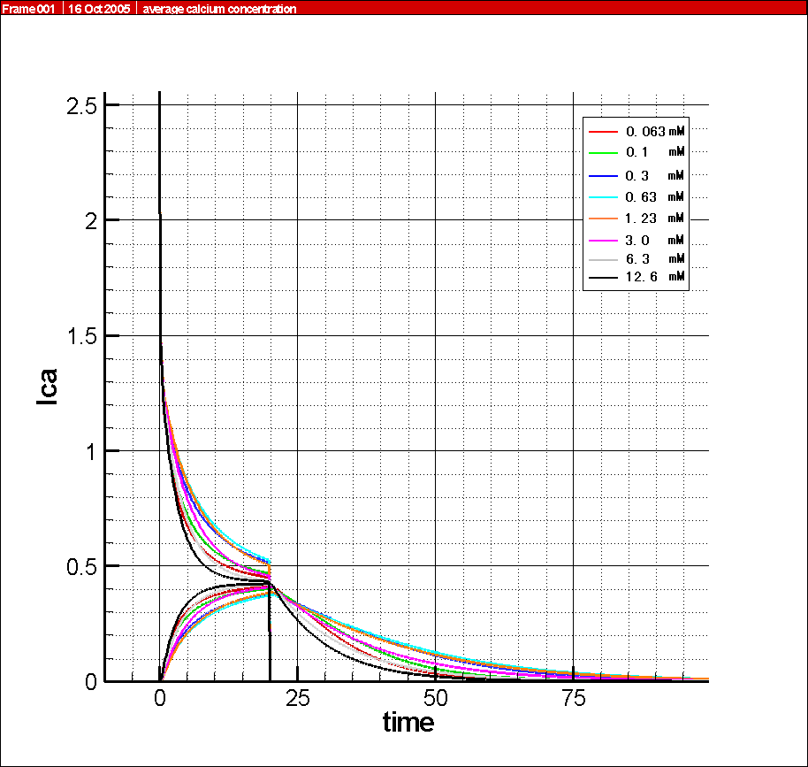
Single RyRC opening with changed Kd,CSQ
Left: Average jSR [Ca2+] versus time
Right: inflow and outflow Calcium currents versus time

Slide 23
Thanks!

